Slide 1
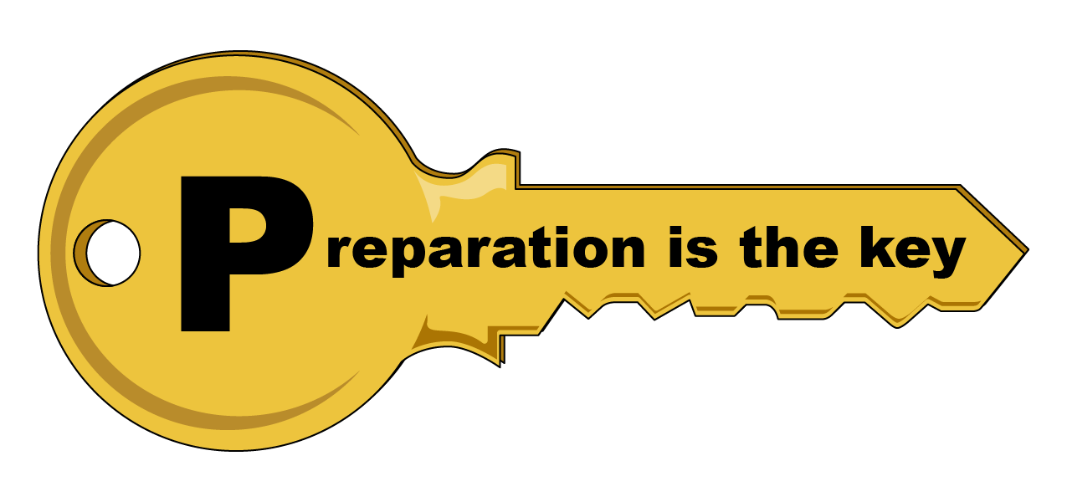
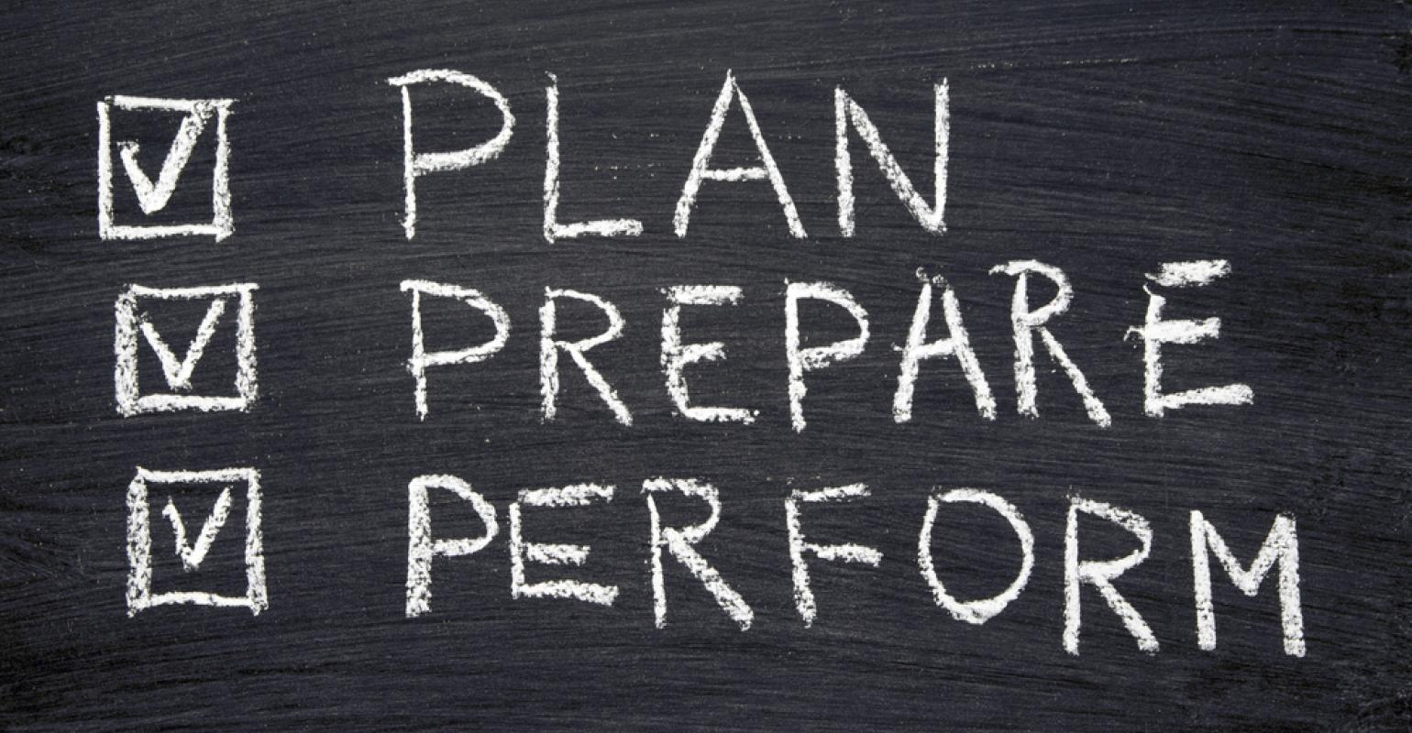
Debate Club #10: Preparation
András Meleg: 11 April 2021

Slide 2
Overview
I: Goals and disclaimers
II: Why is it important?
III: Real-life debates
IV: The ultrastandard
V: Bramble-style
VI: 4 pillar-style
VIII: General preparation
IX: Debate
VII: Notemaking
I, III: Real-life execution of workshop
II, VII, VIII, IX:
Debate & strategy
IV, V, VI: preparation strategies

Slide 3
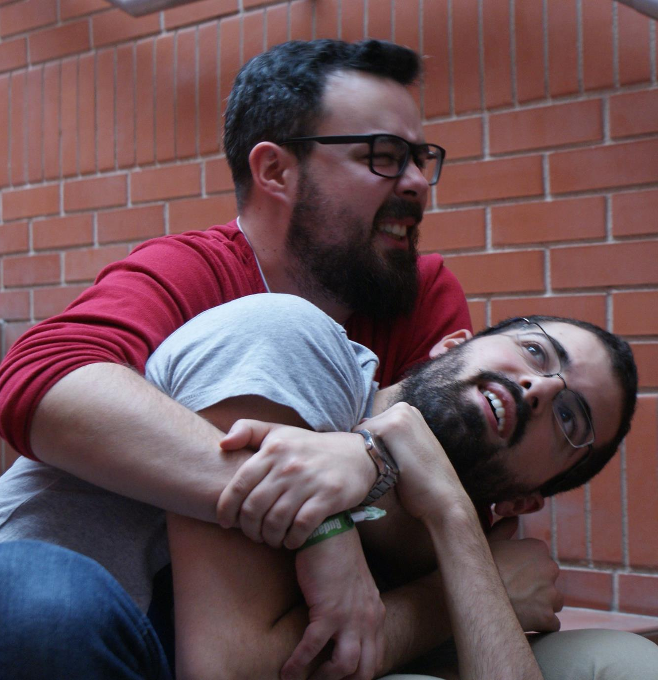
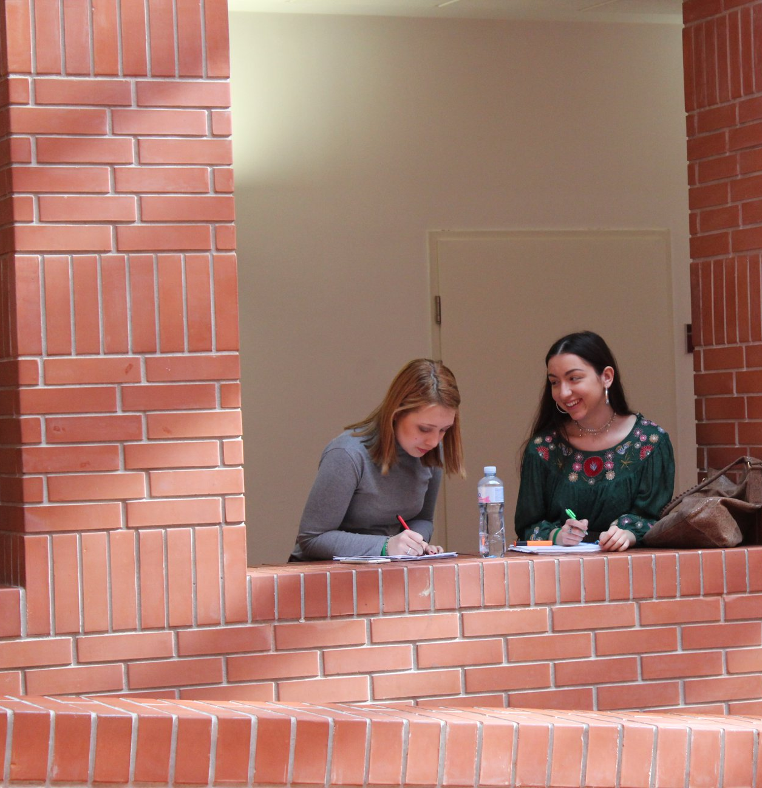
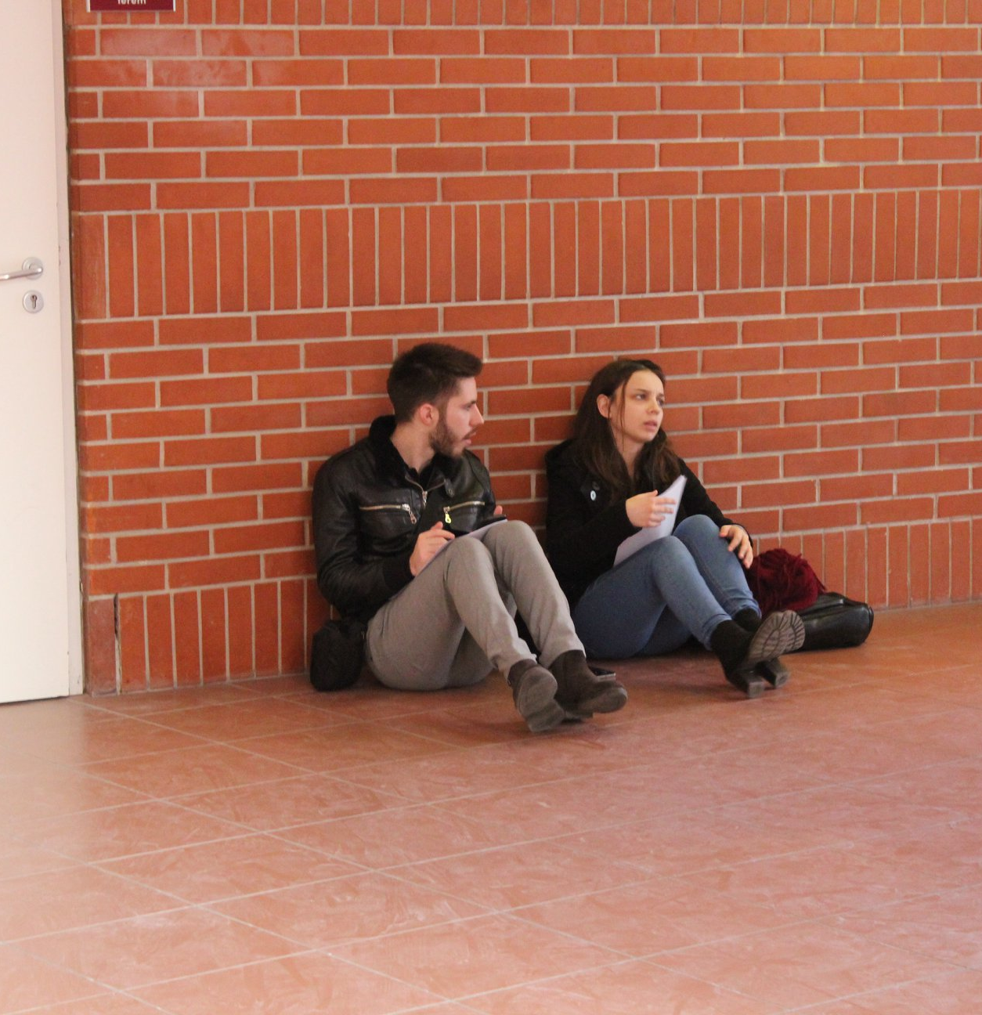
Which team would you rather be?

Slide 4
I: Goals and disclaimers
Don’t panic: if you panic, you don’t think!
Know what is efficient
Next debates : use these tecniques
Next exams: help your logical structure
Disclaimers
There is no perfect method
Practice, practice, practice
Acquire the acutal skill
Goals: calm, efficient, mutual teamwork
Have common plan for debates

Slide 5
II: Why is it important?
Impact:
how important is what I say?
Opposition
Mechanism:
how true is what I say?
Government

Slide 6
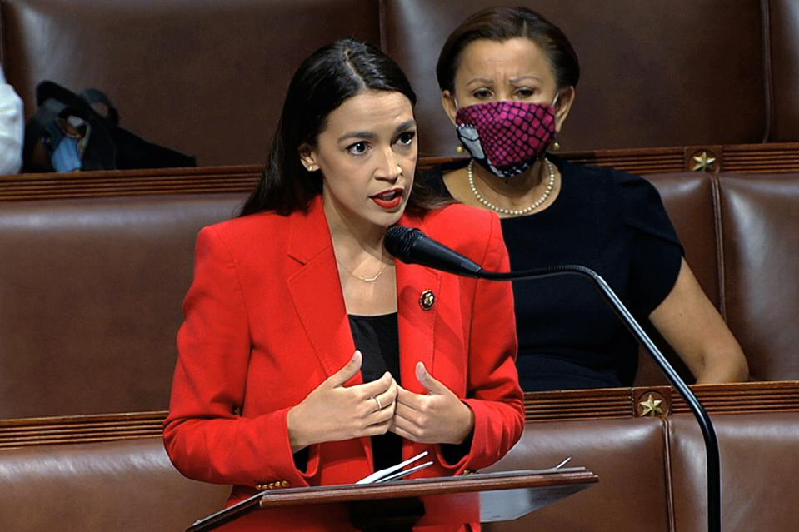
II: Why is it important?
Impact:
how important is what I say?
Opposition
A3
A1
A2
Mechanism:
how true is what I say?
Government

Slide 7
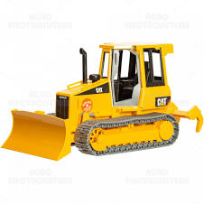
II: Why is it important?
Impact:
how important is what I say?
Opposition
Refutation bulldozer
A1
A3
Mechanism:
how true is what I say?
A2
Government

Slide 8
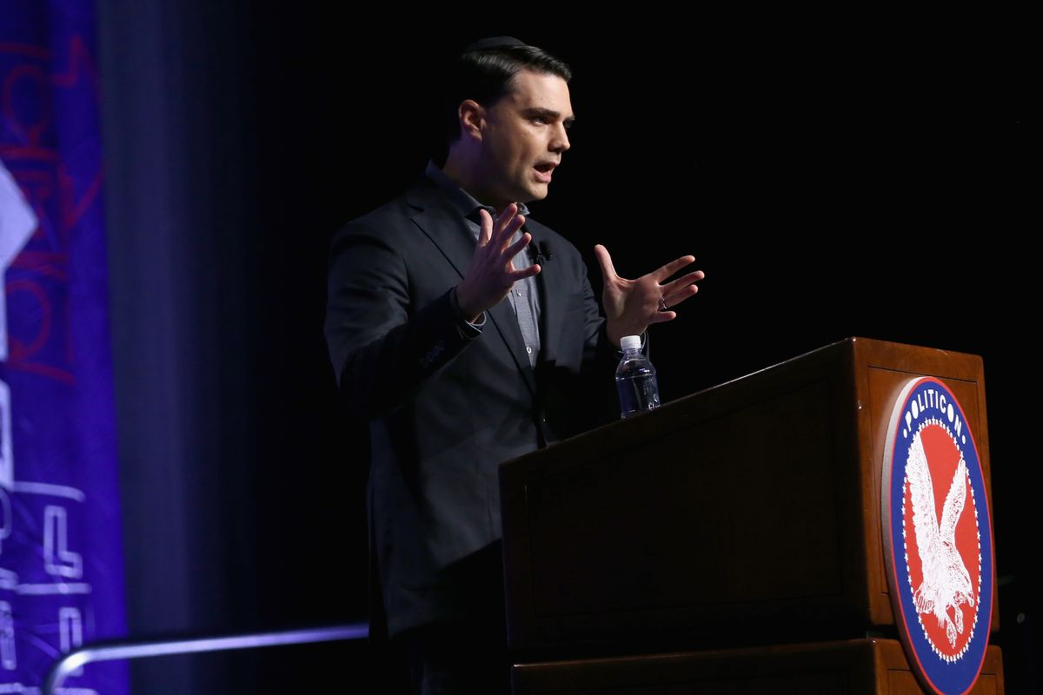
II: Why is it important?
Impact:
how important is what I say?
Opposition
B3
B2
B1
A1
A3
Mechanism:
how true is what I say?
A2
Government

Slide 9
II: Why is it important?
Impact:
how important is what I say?
Opposition
B3
B2
B1
Refutation bulldozer
A1
A3
A1
Mechanism:
how true is what I say?
A2
A2
Government

Slide 10
II: End of the debate
Impact:
how important is what I say?
Opposition
B2
B1
B3
A3
A1
Mechanism:
how true is what I say?
A2
Government

Slide 11
II: End of the debate
How important?
B2
A3
B1
A1
B3
A2
How true?

Slide 12
III: Relation to real-life debates
Preparations provide you with 3 assets
Relevance: impact
Clear way to find important arguments: prioritization
Helps to find „storyline” in arguments for structure
Public speaking essentials
Improve quick on-the-feet thinking
Handy in edgy situations
Exams
Auditor works
Analysis
Systemic analysis of your study notes
Decision-making in your life

Slide 13
IV: The Ultra

Slide 14
IV: The Ultra-standard

Slide 15
IV: The Ultra-standard
0-5 minutes: argument generation
5-12 minutes: Filtering
13-15 minutes: Structure

Slide 16
THW ban political conversations at family gatherings
0-5 minutes: argument generation
5-12 minutes: Filtering
13-15 minutes: Structure

Slide 17
V: Bramble-Style
0-2: what’s the debate?
„What is the spirit of motion?”
One-sided clashes?
2-9: Generation
as many args as possible
Stakeholders
10-13: filter
Are your args plausible in real world? → possible 1-liner rebutts?
Clear logical progression?
14-15: structure
Muscle-memory: debating is a sport

Slide 18
V: Bramble-Style
0-2: what’s the debate?
„What is the spirit of motion?”
One-sided clashes?
2-9: Generation
as many args as possible
Stakeholders
10-13: filter
Are your args plausible in real world? → possible 1-liner rebutts?
Clear logical progression?
14-15: structure
Muscle-memory: debating is a sport
Goal
Ways
Simplicity
Story

Slide 19
THW ban zoos
0-2: what’s the debate?
„What is the spirit of motion?”
One-sided clashes?
2-9: Generation
as many args as possible
Stakeholders
10-13: filter
Are your args plausible in real world? → possible 1-liner rebutts?
Clear logical progression?
14-15: structure
Muscle-memory: debating is a sport
Goal
Ways
Simplicity
Story

Slide 20
V: Bramble-style
1st speaker writes more
2nd speaker constantly talks to 1st speaker how to explain things
2nd speaker must understand the case: can fill in what #1 misses
So far this was OG and OO

Slide 21
Closing teams Bramble-style
0-4: what’s the debate?
priority to understand what the debate is about
5-13: Generation
as many args as possible
Stakeholders
14-15 filter
Arguments should be different ways to explain the same point

Slide 22
VI: 4-pillar strategy: a game of trust
0-5: fixing the pillars
1st speaker: easies, prebuttals
2nd speaker: spirit of motion, stakeholder analysis, „red flags”
6-10: catch-up
2nd speaker starts: helps to set up storyline and advanced arguments
1st speaker follows up and connects stakeholders with easies
11-13: Filtering
2nd speaker may input advanced arguments
1st speaker filters down arguments
14-15: Structure
2nd speaker thinks about strong POI-s
1st speaker clears their head for the 1st speech

Slide 23
VI: THW introduce a compulsary cycling license
Easies
Prebuttals
„What is the debate?”
Stakeholders
Red flags?

Slide 24
Timers
Spirit
Arg. Gen.
separate
catchup
filter
structure
Ultra
Bramble Opening
Bramble Closing
4 pillars

Slide 25
VII: Notemaking technique
Make note from everything
Make sure they are readable why speaking ←→ debate notes are not for „learning” → big distance
no expressive detail → the more actively you think, the easier flow for audience
clear order: f.e.: piles
Subpoints on different points of paper
CG / CO: easier to drop a paper than to cross half of the paper
Struggle with impact? Paper: IMPACT
USE COLOURS / bold + itallic!
Yellow highlighter
POI / Rebutt → very important as a judge

Slide 26
VIII: Preparation: life-preparation
Teamwork: choose a partner you are happy to spend your time with
End of 1 day debating: stressful and long
You should have similar goals: wanna win? Wanna meet people? Wanna have fun and travel? Wanna build your CV? Wanna learn about the world?
Food, drink, medicine, sleep, priorities
Casefiles:
It’s the next step to become professional: countries in alphabetic order?
Some casefile books do exist
most time-consuming –> none of us has yet
these arguments are not nuanced nor’ broad enough after you reached a certain level but can be helpful
makes training easier → it has the easies

Slide 27
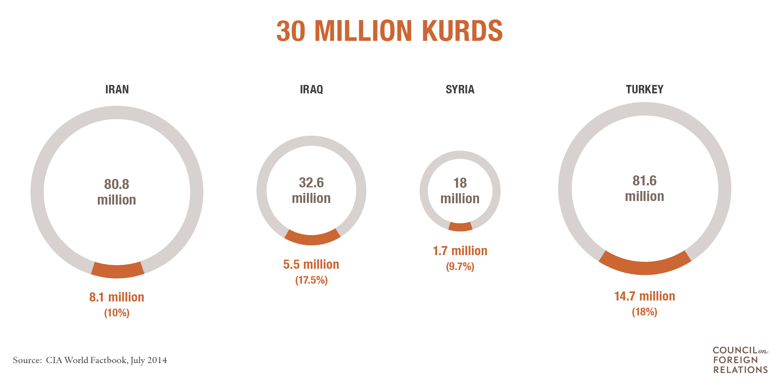
Arguments in case-file?
Waste of time? → content is too much
Casefile:
„Oh, shit, what should I do? What I don’t know about life?”
„What are the hot topics these days?”
„What facutal claims debates may hinge upon?”
Where to start: Council on Foreign Relations: cfr.org
Pop-up cases
Info-guide explainers

Slide 28
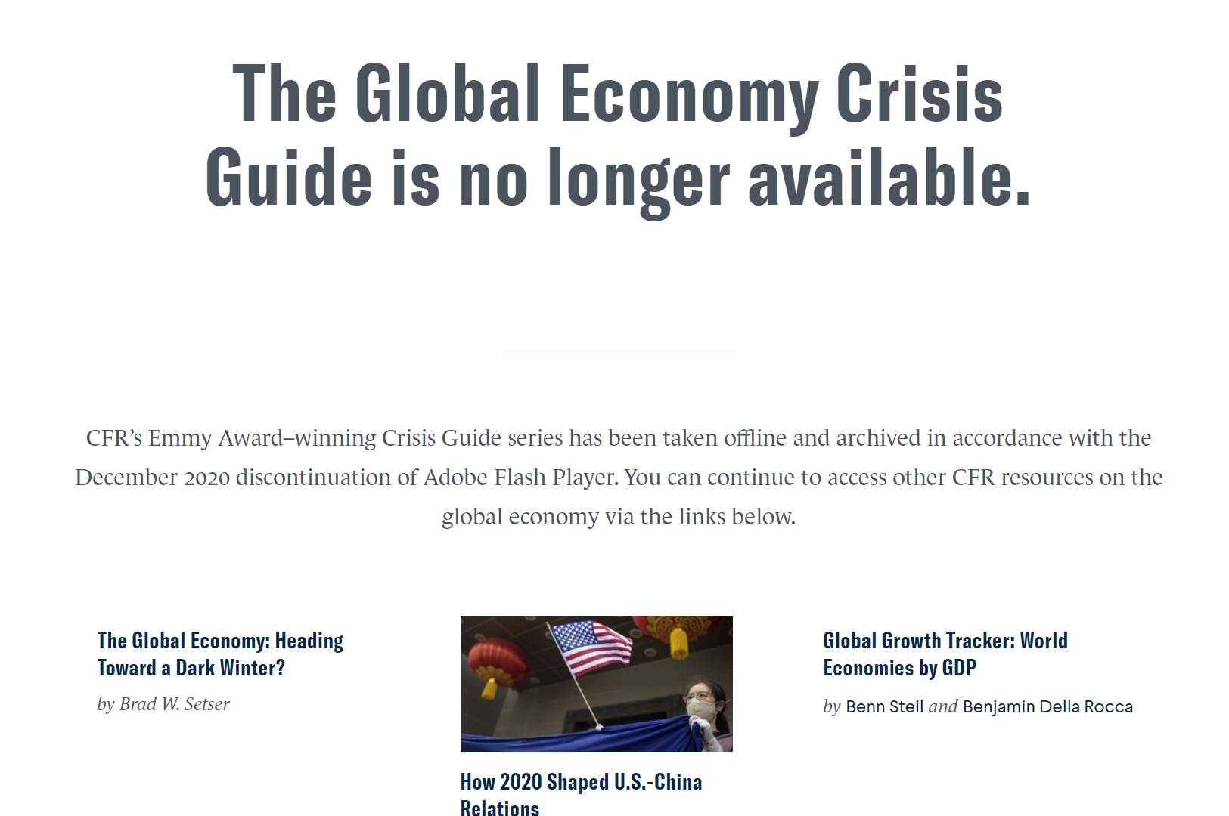
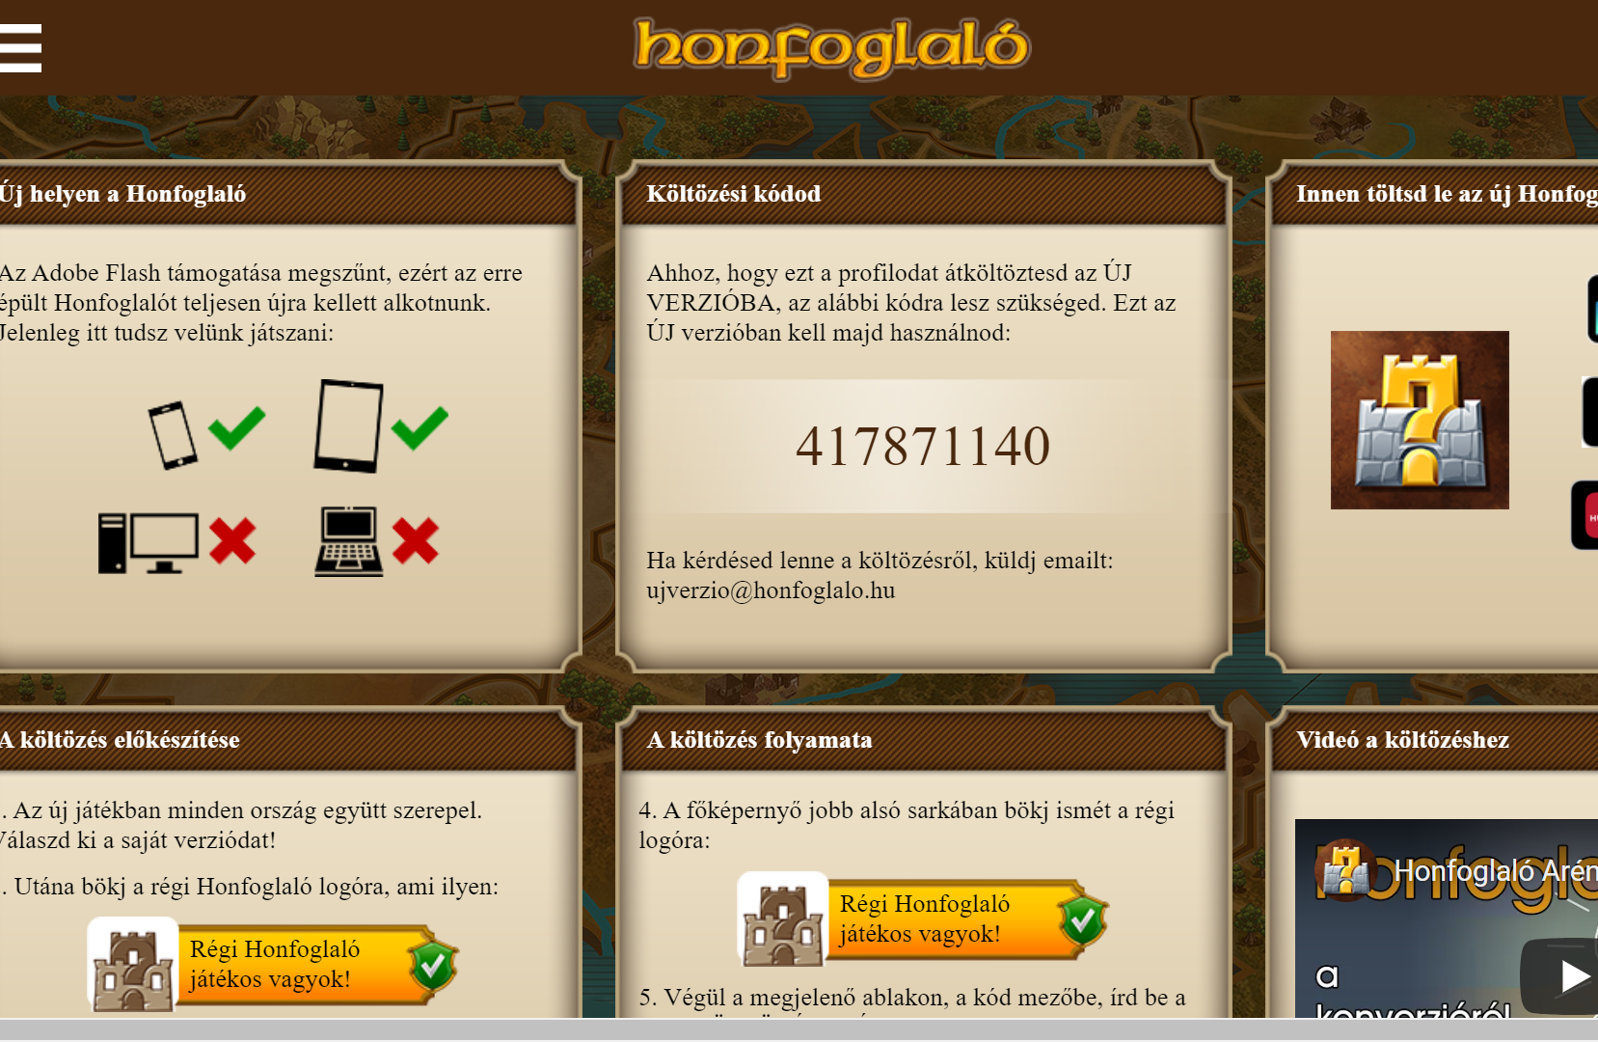
Btw fuck you Adobe Flash Player

Slide 29
Task: what are the hot topics these days?

Slide 30
Task: what are the hot topics these days?
Covid + vaccines
Global warming
Russia & Ukraine: NATO, US Foreign Policy, Russian Foreign Policy
Etc.

Slide 31
Sources
Workshop by Daniel Bramble on Preparation and adapting: https://www.youtube.com/watch?v=GtISV17Pc6Q&list=PLYpgvIfkOnWvFK9nDbkLqaP46sX2P-nZY&index=48
Workshop by Amanda Moorghen on Preparing for EUDC: https://www.youtube.com/watch?v=JUt0hWJwB4M

Slide 32
IX: What to keep in mind during today’s Debate?
Choose a strategy:
ultra,
Brumble,
4 pillar strat
Choose a teammate
Think about how notemaking technique is effective with your choosen strategy
Ready, set: go!
Opening Government
Opening Opposition
Peter
Gyuri, Kristina
Andris, Ádám
Ruben
Closing Government
Closing Opposition

Slide 33
Our last few debate motions:
March 22: This House Regrets the 2004 and since (South)-Eastern expansion of the European Union.
March 29: This House Would implement a direct democracy application.
April 1: This House Would introduce a road toll in Budapest.
April 5: This House Would introduce a 50% female quote for higher education spots in traditionally male professions.

